Slide 1
GAN
LEARNING DISTRIBUTION
GAN MODEL
OBJECTIVE FUNCTIONS
APPLICATION

Slide 2
Generative adversarial network
GAN is a deep neural network architecture comprise of two neural network , competing against the other (i.e. adversarial)
GAN are neural network that are trained in adversarial manner to generate data mimicking some distribution
Two classes are
Discriminator: discriminate between two different classes of data.
Generative model : A generative model G to be trained on training data x sampled from some true distribution D is the one which given some standard random distribution

Slide 3
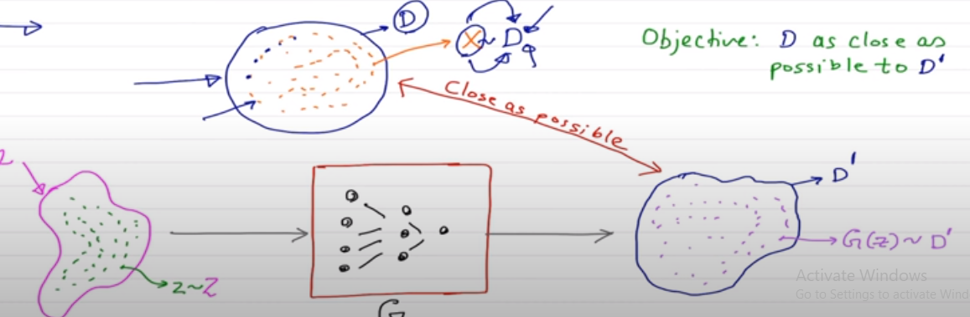
Distribution learning
Z produces a distribution D` which is close to D according to some closeness matrix
G(z) ~ D`

Slide 4
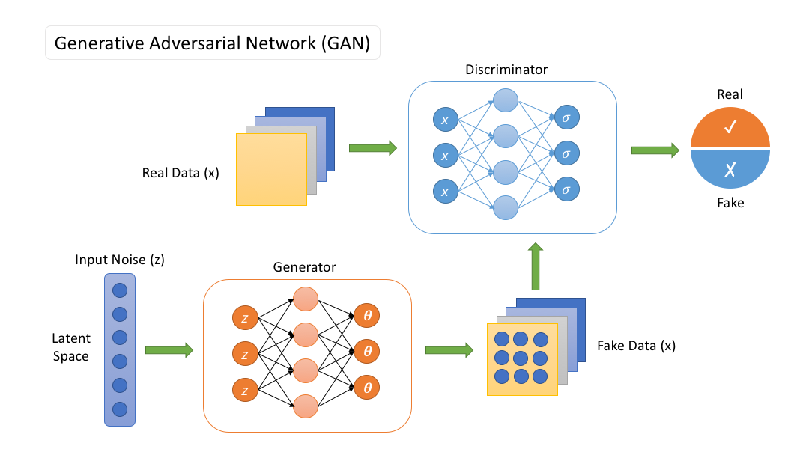
GAN MODEL

Slide 5
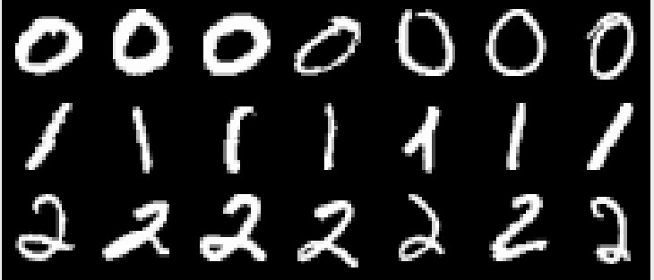
As usual we are given some training data (say, MNIST images) which obviously comes from some underlying distribution
Our goal is to generate more images from this distribution (i.e., create images which look similar to the images from the training data)
In other words, we want to sample from a complex high dimensional distribution which is intractable (recall RBMs, VAEs and AR models deal with this intractability in their own way)
4/38
CS7015 (Deep Learning) : Lecture 23

Slide 6


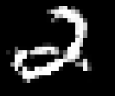


Complex Transformation
Sample Generated
z ∼ N (0, I)
GANs take a different approach to this problem where the idea is to sample from a simple tractable distribution (say, z ∼ N (0, I)) and then learn a complex transformation from this to the training distribution
5/38
CS7015 (Deep Learning) : Lecture 23

Slide 7
Complex Transformation
Sample Generated
z ∼ N (0, I)
GANs take a different approach to this problem where the idea is to sample from a simple tractable distribution (say, z ∼ N (0, I)) and then learn a complex transformation from this to the training distribution
In other words, we will take a z ∼ N (0, I), learn to make a series of complex transformations on it so that the output looks as if it came from our training distribution
5/38
CS7015 (Deep Learning) : Lecture 23

Slide 8
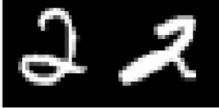
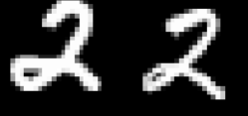


What can we use for such a complex transformation? A Neural Network
Real or Fake
How do you train such a neural network? Using a two player game
There are two players in the game: a generator and a discriminator
The job of the generator is to produce images which look so natural that the discriminator thinks that the images came from the real data distribution
The job of the discriminator is to get better and better at distinguishing between true images and generated (fake) images
Discriminator
Generator
Real Images
z ∼ N (0, I)
6/38
CS7015 (Deep Learning) : Lecture 23

Slide 9
GAN
Let G_{φ} be the generator and D_{θ} be the discriminator (φ and θ are the parameters of G and D, respectively)
We have a neural network based generator which takes as input a noise vector z ∼ N (0, I) and produces G_{φ}(z) = X
We have a neural network based discriminator which could take as input a real X or a generated X = G_{φ}(z) and classify the input as real/fake
Real or Fake
Discriminator
Generator
Real Images
z ∼ N (0, I)
7/38
CS7015 (Deep Learning) : Lecture 23

Slide 10
What should be the objective function of the overall network?
Real or Fake
Discriminator
Let’s look at the objective function of the generator first
Given an image generated by the generator as G_{φ}(z) the discriminator assigns a score D_{θ} (G_{φ}(z)) to it
This score will be between 0 and 1 and will tell us the probability of the image being real or fake
For a given z, the generator would want to maximize log D_{θ} (G_{φ}(z)) (log likelihood) or minimize log(1 − D_{θ} (G_{φ}(z)))
Generator
Real Images
z ∼ N (0, I)
8/38
CS7015 (Deep Learning) : Lecture 23

Slide 11
This is just for a single z and the generator would like to do this for all possible values of z,
Generator
Real or Fake
For example, if z was discrete and drawn from a
uniform distribution (i.e., p(z) = ¹ ∀z) then the
Discriminator
N
generator’s objective function would be
N
Σ
1
N
min
φ
log(1 − D (G (z)))
θ φ
Generator
Real Images
i=1
However, in our case, z is continuous and not uniform (z ∼ N (0, I)) so the equivalent objective function would be
z ∼ N (0, I)
ˆ
min p(z) log(1 − D (G (z)))
θ φ
φ
min E_{z∼p(z)} [log(1 − D_{θ} (G_{φ}(z)))]
φ
9/38
CS7015 (Deep Learning) : Lecture 23

Slide 12
Discriminator
Real or Fake
Discriminator
The task of the discriminator is to assign a high score to real images and a low score to fake images
And it should do this for all possible real images and all possible fake images
In other words, it should try to maximize the following objective function
Generator
Real Images
z ∼ N (0, I)
max E [log D_{θ} (x)]+E_{z∼p(z)}[log(1−D_{θ} (G_{φ}(z)))]
θ
^{x∼p}data
10/38
CS7015 (Deep Learning) : Lecture 23

Slide 13
objectives of the generator and discriminator : a minimax game
Real or Fake
Discriminator
min max log D_{θ} (x)
φ θ
+ E_{z∼p(z)} log(1 − D_{θ} (G_{φ}(z)))]
^{[E}x∼p
data
The first term in the objective is only w.r.t. the parameters of the discriminator (θ)
The second term in the objective is w.r.t. the parameters of the generator (φ) as well as the discriminator (θ)
The discriminator wants to maximize the second term whereas the generator wants to minimize it (hence it is a two-player game)
Generator
Real Images
z ∼ N (0, I)
11/38
CS7015 (Deep Learning) : Lecture 23

Slide 14
Training Process
Real or Fake
Discriminator
Step 1: Gradient Ascent on Discriminator
max [E_{x∼pdata} log D_{θ} (x)+E_{z∼p(z)} log(1−D_{θ} (G_{φ}(z)))]
θ
Step 2: Gradient Descent on Generator
Generator
Real Images
min E_{z∼p(z)} log(1 − D_{θ} (G_{φ}(z)))
φ
https://towardsdatascience.com/decoding-the-basic-math-in-gan-simplified-version-6fb6b079793
z ∼ N (0, I)
12/38
CS7015 (Deep Learning) : Lecture 23

Slide 15
Training
Real or Fake
Step 1: Gradient Ascent on Discriminator
Discriminator
max [E_{x∼pdata} log D_{θ} (x)+E_{z∼p(z)} log(1−D_{θ} (G_{φ}(z)))]
θ
Step 2: Gradient Descent on Generator
Generator
Real Images
min E_{z∼p(z)} log(1 − D_{θ} (G_{φ}(z)))
φ
In practice, the above generator objective does not work well and we use a slightly modified objective
Let us see why
z ∼ N (0, I)
12/38
CS7015 (Deep Learning) : Lecture 23

Slide 16
When the sample is likely fake, we want to give a feedback to the generator (using gradients)
4
log(1 − D(g(x)))
— log(D(g(x)))
2
Loss
0
However, in this region where D(G(z)) is close to 0, the curve of the loss function is very flat and the gradient would be close to 0
Trick: Instead of minimizing the likelihood of the discriminator being correct, maximize the likelihood of the discriminator being wrong
In effect, the objective remains the same but the gradient signal becomes better
−2
−4
0.2 0.4 0.6 0.8
D(G(z))
0
1
13/38
CS7015 (Deep Learning) : Lecture 23

Slide 17
With that we are now ready to see the full algorithm for training GANs
1: procedure GAN Training
2: for number of training iterations do
3:
4:
5:
6:
for k steps do
Sample minibatch of m noise samples {z⁽¹⁾, .., z^{(m)}} from noise prior p_{g} (z)
Sample minibatch of m examples {x⁽¹⁾, .., x^{(m)}} from data generating distribution p_{data}(x)
Update the discriminator by ascending its stochastic gradient:
m
1
m
Σ
∇_{θ}
^{h}log D_{θ} x^{(i)} + log 1 − D_{θ} G_{φ} z^{(i) i}
i=1
7:
8:
9:
end for
Sample minibatch of m noise samples {z⁽¹⁾, .., z^{(m)}} from noise prior p_{g} (z)
Update the generator by ascending its stochastic gradient
m
h i
1
m
Σ
∇_{φ}
log D_{θ} G_{φ} z^{(i)}
i=1
10: end for
11: end procedure
14/38
CS7015 (Deep Learning) : Lecture 23

Slide 18
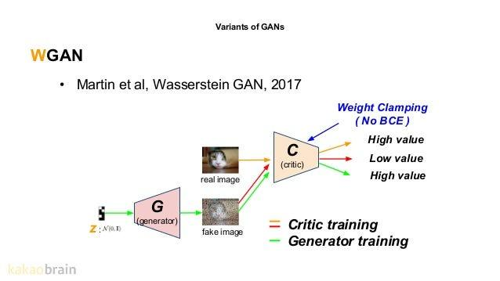
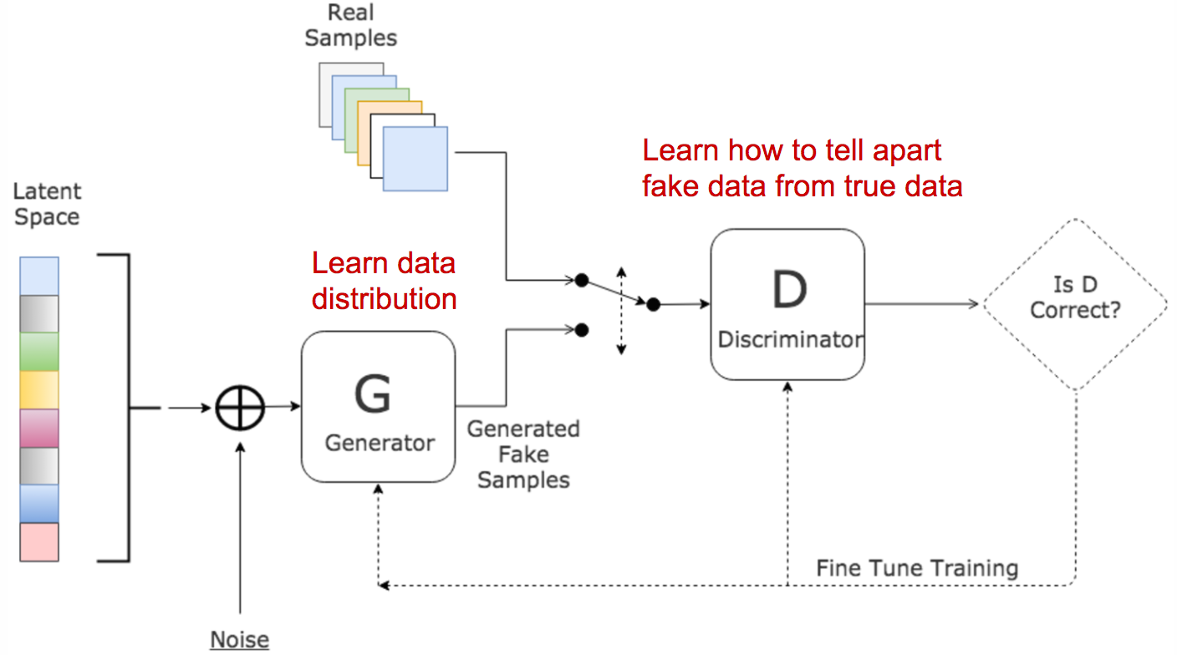
GAN vs WGAN

Slide 19
WGAN Loss function
without the sigmoid function and outputs a scalar score rather than a probability. This score can be interpreted as how real the input images are.
We rename the discriminator to critic to reflect its new role.

Slide 20
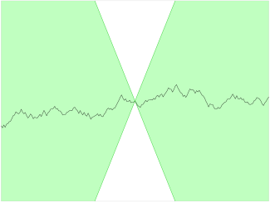
The Lipschitz Constraint
It may surprise you that we are now allowing the critic to output any number in the range [–∞, ∞], rather than applying a sigmoid function to restrict the output to the usual [0, 1] range.

Slide 21

The Lipschitz Constraint
The critic is a function D that converts an image into a prediction. We say that this function is 1-Lipschitz if it satisfies the following inequality for any two input images, x₁ and x₂:
Here, x₁ – x₂ is the average pixel wise absolute difference between two images and D(x1)-D(x2) is the absolute difference between the critic predictions. Essentially, we require a limit on the rate at which the predictions of the critic can change between two images (i.e., the absolute value of the gradient must be at most 1 everywhere).
https://jonathan-hui.medium.com/gan-wasserstein-gan-wgan-gp-6a1a2aa1b490

Slide 22
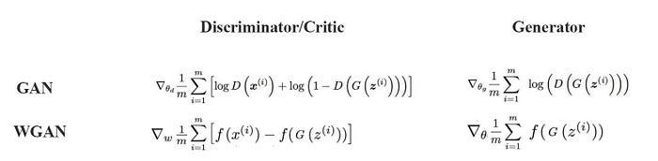
GAN vs WGAN
f has to be a 1-Lipschitz function.

Slide 23
To enforce 1-Lipschitz function.
Weight Clipping
Gradient Penalty

Slide 24
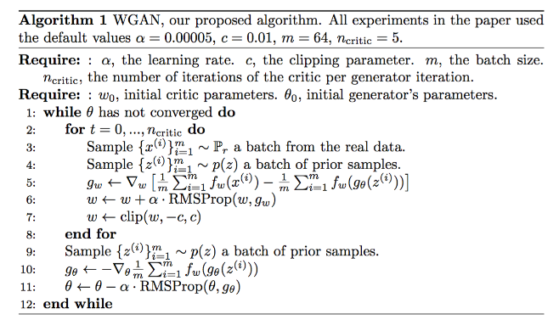
WGAN Algorithm with weight clipping

Slide 25
Issues
Quote from the research paper: Weight clipping is a clearly terrible way to enforce a Lipschitz constraint. If the clipping parameter is large, then it can take a long time for any weights to reach their limit, thereby making it harder to train the critic till optimality. If the clipping is small, this can easily lead to vanishing gradients when the number of layers is big, or batch normalization is not used (such as in RNNs) … and we stuck with weight clipping due to its simplicity and already good performance.
The model performance is very sensitive to this hyperparameter. In the diagram below, when batch normalization is off, the discriminator moves from diminishing gradients to exploding gradients when c increases from 0.01 to 0.1.

Slide 26
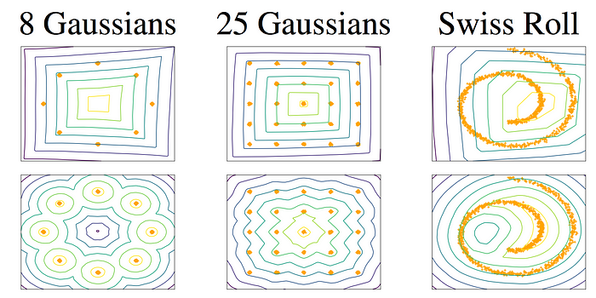
Issue with weight clipping
The weight clipping behaves as a weight regulation. It reduces the capacity of the model f and limits the capability to model complex functions.

Slide 27
To enforce Lipschitz constraint.
WGAN-GP uses gradient penalty instead of the weight clipping to enforce the Lipschitz constraint.
Gradient penalty
A differentiable function f is 1-Lipschitz if and only if it has gradients with norm at most 1 everywhere.

Slide 28

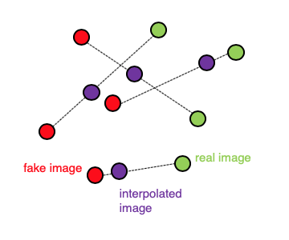
Loss function of WGAN
λ is set to 10. The point x used to calculate the gradient norm is any points sampled between the Pg and Pr.

Slide 29
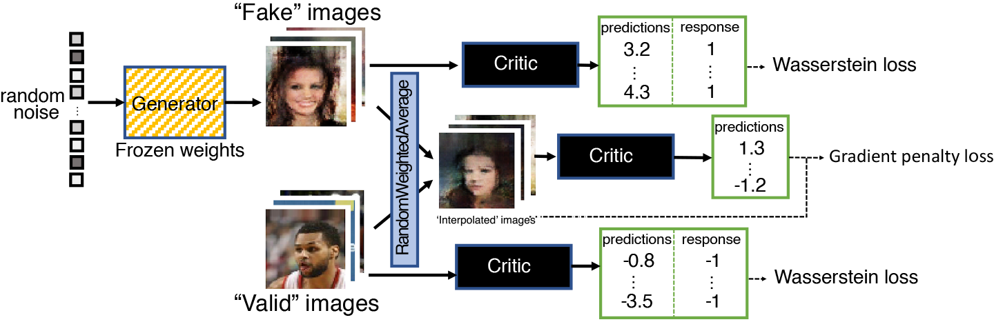
Gradient Penalty Loss

Slide 30
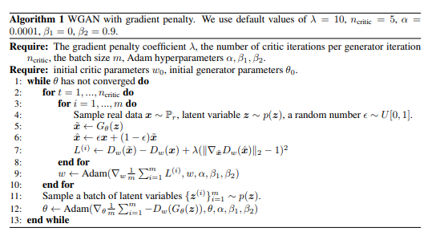
WGAN : Gradient Penalty

Slide 31
Module 23.2: Generative Adversarial Networks - Architecture
CS7015 (Deep Learning) : Lecture 23

Slide 32
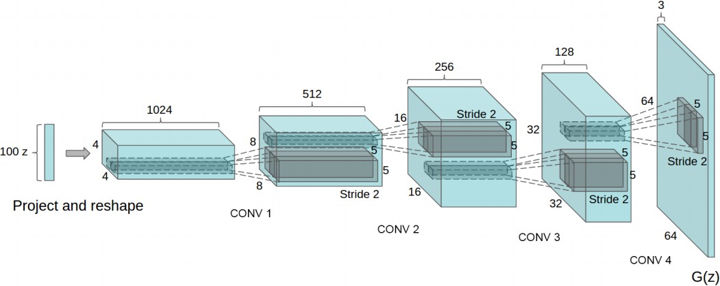
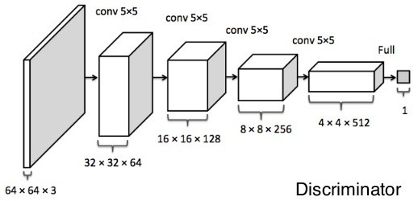
We will now look at one of the popular neural networks used for the generator and discriminator (Deep Convolutional GANs)
For discriminator, any CNN based classifier with 1 class (real) at the output can be used (e.g. VGG, ResNet, etc.)
FIGURE: GENERATOR (REDFORD ET AL 2015) (LEFT) AND DISCRIMINATOR (YEH ET AL 2016) (RIGHT) USED IN DCGAN
16/38
CS7015 (Deep Learning) : Lecture 23

Slide 33
Architecture guidelines for stable Deep Convolutional GANs
Replace any pooling layers with strided convolutions (discriminator) and fractional-strided convolutions (generator).
Use batchnorm in both the generator and the discriminator. Remove fully connected hidden layers for deeper architectures.
Use ReLU activation in generator for all layers except for the output, which uses tanh.
Use LeakyReLU activation in the discriminator for all layers
17/38
CS7015 (Deep Learning) : Lecture 23

Slide 34
Module 23.4: Generative Adversarial Networks - Some Cool Stuff and Applications
CS7015 (Deep Learning) : Lecture 23

Slide 35
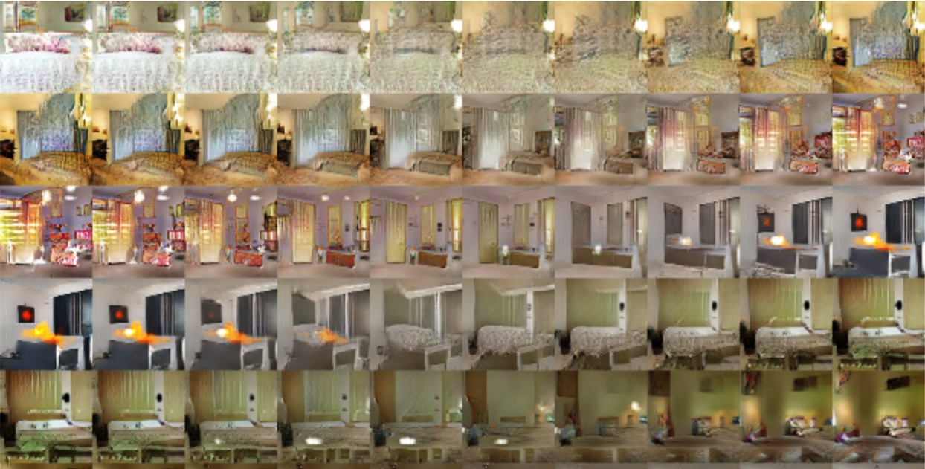
In each row the first image was generated by the network by taking a vector
z₁ as the input and the last images was generated by a vector z₂ as the input
All intermediate images were generated by feeding z’s which were obtained by interpolating z₁ and z₂ (z = λz₁ + (1 — λ)z₂)
As we transition from z₁ to z₂ in the input space there is a corresponding smooth transition in the image space also
33/38
CS7015 (Deep Learning) : Lecture 23

Slide 36
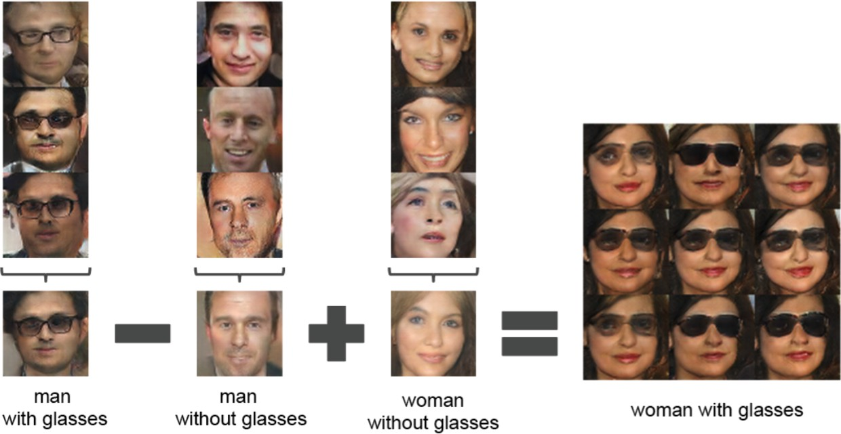
The first 3 images in the first column were generated by feeding some
z₁₁, z₁₂, z₁₃ respectively as the input to the generator
The fourth image was generated by taking an average of z₁ = z₁₁, z₁₂, z₁₃ and feeding it to the generator
Similarly we obtain the average vectors z₂ and z₃ for the 2nd and 3rd columns If we do a simple vector arithmetic on these averaged vectors then we see the corresponding effect in the generated images
34/38
CS7015 (Deep Learning) : Lecture 23

Slide 37
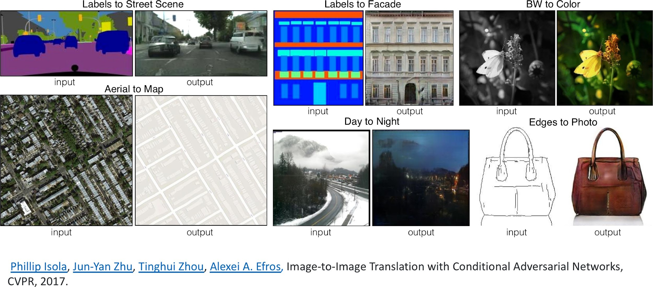
CS7015 (Deep Learning) : Lecture 23

Slide 38
Module 23.5: Bringing it all together (the deep generative summary)
CS7015 (Deep Learning) : Lecture 23

Slide 39
Table: Comparison of Generative Models
 | RBMs | VAEs | AR models | GANs
Abstraction | Yes | Yes | No | No
Generation | Yes | Yes | Yes | Yes
Compute P(X) | Intractable | Intractable | Tractable | No
Sampling | MCMC | Fast | Slow | Fast
Type of GM | Undirected | Directed | Directed | Directed
Loss | KL-divergence | KL-divergence | KL-divergence | JSD
Assumptions | X independent given z | X independent given z | None | N.A.
Samples | Bad | Ok | Good | Good (best)
Recent works look at combining these methods: e.g. Adversarial Autoencoders (Makhzani 2015), PixelVAE (Gulrajani 2016) and PixelGAN Autoencoders (Makhzani 2017)
37/38
CS7015 (Deep Learning) : Lecture 23

Slide 40
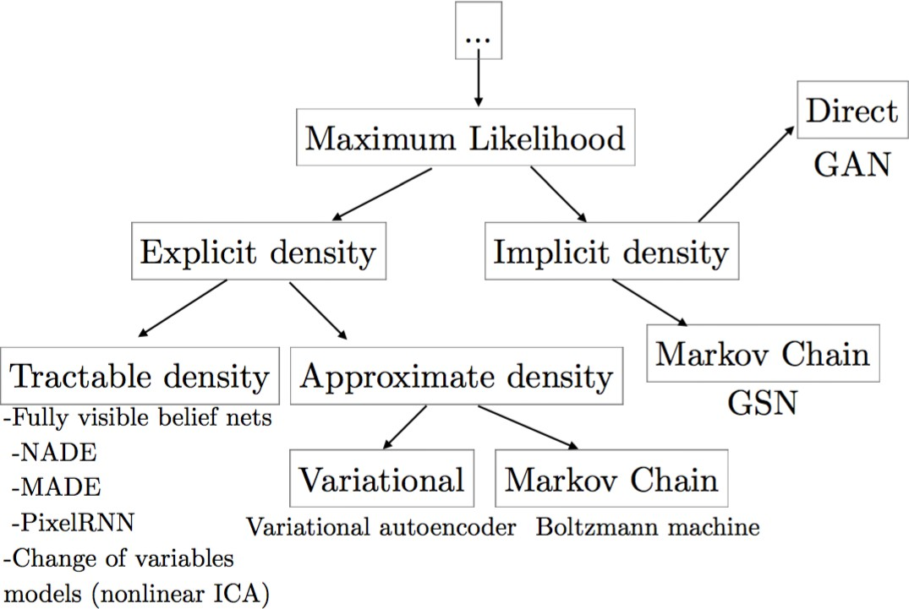
Source: Ian Goodfellow, NIPS 2016 Tutorial: Generative Adversarial Networks
38/38
CS7015 (Deep Learning) : Lecture 23

